Slide 1
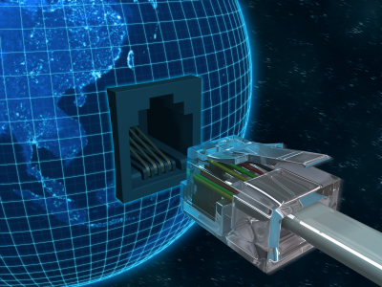
Home
Monitoring and Control System

Slide 2
Abstract
Internet of Things (IoT) conceptualizes the idea of remotely connecting and monitoring real world objects (things) through the Internet. When it comes to our house, this concept can be aptly incorporated to make it smarter, safer and automated. But the current systems available in the market are very much costlier.
This IoT project focuses on building a smart wireless home monitoring and control system which gives alerts to the owner by using wi-fi module in case of any trespass and raises an alarm optionally. Besides, many other things are also implemented with the help of various sensors.
With the use of ESP8266 Wi-Fi Module various features are implemented which results in low cost home monitoring and control system.

Slide 3
Literature Review
Sr. No | YEAR | INVENTION | DESCRIPTION | LIMITATION
1 | 1920 | Invention of home appliances | The first engine powered vacuum cleaner, refrigerators clothes dryers, washing machines, irons, toasters, and so much more | Devices are in their primary stage
2 | 1966 | ECHO IV and The Kitchen Computer | It was the first smart device Clever device could compute shopping lists, control the home’s temperature and turn appliances on and off | Cost and size is high so they never sold commercially
3 | 1998 | Smart Homes | A viable technology for consumers Domestic technologies, home networking began to appear on store shelves. | Dedicated for only one purpose i.e. Automation
4 | 2017 | Today’s Smart Home | Today’s smart homes are more about security and living greener Current trends in home automation include remote mobile control, automated lights, automated surveillance. | Internet connection is required

Slide 4
Problem Definition:
During the information stage main problem statements for current systems are as below:
A common property of successful inventions is the abilities to make life easier. For example Washing Machine, making washing less burdensome.
Tragedies happen such as thefts especially late at night when the users are not at home. This is because home does not provide any secure system.

Slide 5
What is Home Automation or HA?
• Home Automation is a wireless home appliance control system accessed by a remote device such as mobile phone( Android or IOs) to allow a home owner to control, monitor and coordinate home appliances, without changing the home infrastructure.

Slide 6
Why Home Automation ?
Saves time
Save money (Long run)
Self Maintenance
Security
Makes life easy

Slide 7
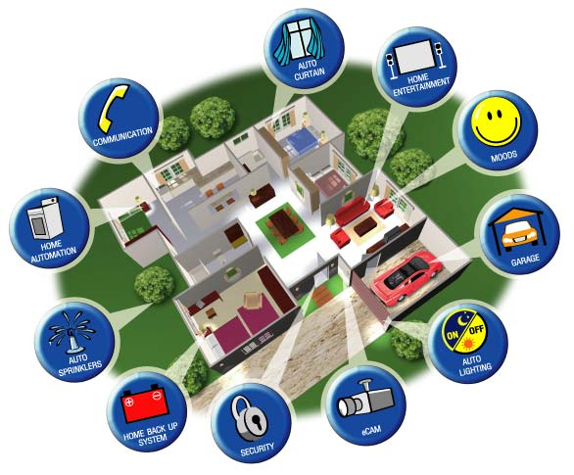
Where is Home Automation going?

Slide 8
Features of smart home:
To create a working model of a smart home having the following features:
Automatic Appliances Switching
Weather Station
Earthquake Detection
Parking Assistance
Fire Detection
Front Door Security
Web Interface

Slide 9
Components Used:
ArduinoUNO
Jumper Wires
Relay(2channel)
Temperature & Humidity Sensor
Buzzer
Push Button
Door Sensor
Fire Sensor
RGB LED
Distance Sensor
NodeMCU ESP8266

Slide 10
Main Components
Wi-Fi Module
Relay

Slide 11
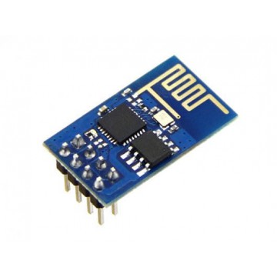
Wi-Fi Module
The ESP8266 Wi-Fi Module is a self contained SOC with integrated TCP/IP protocol stack that can give any microcontroller access to your Wi-Fi network.
The ESP8266 is capable of either hosting an application or offloading all Wi-Fi networking functions from another application processor.

Slide 12
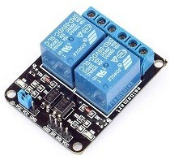
Relay
A relay is an electrically operated switch of mains voltage. It means that it can be turned on or off, letting the current go through or not. Controlling a relay with the Arduino is as simple as controlling an output such as an LED

Slide 13
Schematic Diagram of HA

Slide 14
Conclusion
Home Automation is undeniably a resource
which can make a home environment automated.
People can control their electrical devices via
these Home Automation devices and set up
controlling actions through Mobile.
In future this product may have high potential for marketing.

Slide 15
Thank You!

